Slide 1
Overview and Recent Advances in Partial Least Squares
Presented by:
Team 21
Nazanin Salehabadi
Shagun Paul

Slide 2
Research Paper Details
Overview and Recent Advances in Partial Least Squares
By Roman Rosipal and Nicole Kramer

Slide 3
Brief Talk Outline
Introduction
What is PLS? PLS using NIPALS Algorithm
Forms of PLS
Projection Method: PCA vs. CCA vs. PLS
PLS Regression
PLS Discrimination and Classification
Nonlinear PLS
Conclusion
Future Scope

Slide 4
Introduction
Partial Least Squares (PLS) is a method for modeling relations between sets of observed variables by means of latent variables.
PLS in its general form creates orthogonal score vectors, commonly referred to as latent vectors by maximising the co-variance between different sets of variables.
Latent Variables are those variables that are hidden and are not directly observed rather they are inferred using mathematical models on other variables.
PLS is mainly used in fields like Chemometrics, Bioinformatics, Food Research, Social Sciences etc.
The scope of this paper is based on two blocks of variables
This paper gives an introduction to different variants of PLS

Slide 5
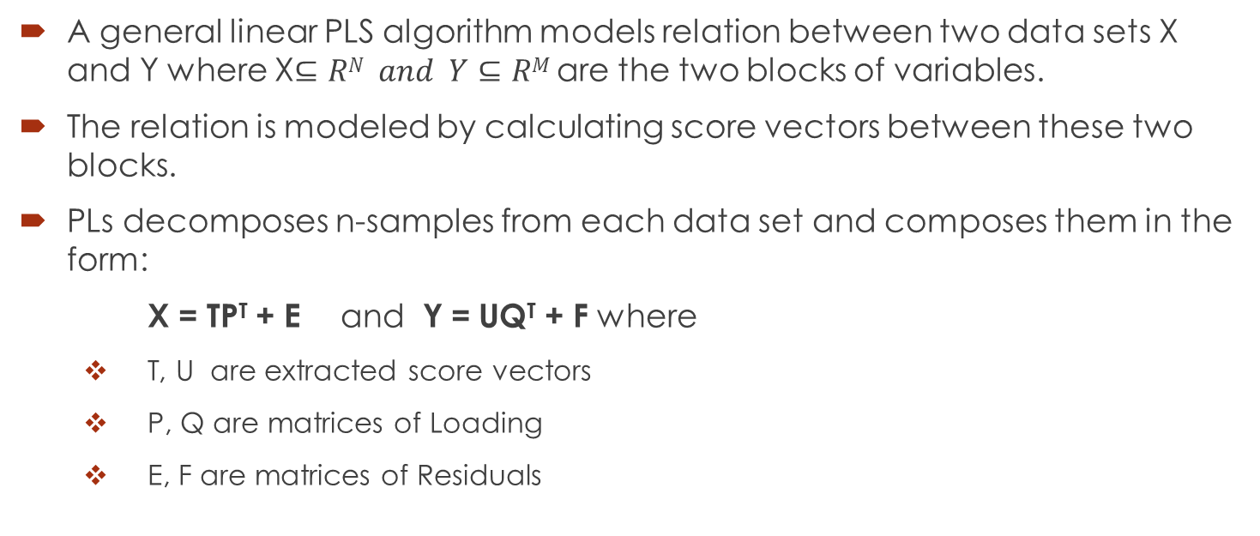
What is PLS?
A general linear PLS algorithm models relation between two data sets X and Y where X$⊆RN and Y⊆RM$ are the two blocks of variables.
The relation is modeled by calculating score vectors between these two blocks.
PLs decomposes n-samples from each data set and composes them in the form:
X = TP^{T} + E and Y = UQ^{T} + F where
T, U are extracted score vectors
P, Q are matrices of Loading
E, F are matrices of Residuals

Slide 6
PLS using NIPALS Algorithm
X and Y datasets are decomposed in two ways using NIPALS algorithm as:
First Way: Convergence Approach
Y-space score vector, u is randomly initialised and then follows the following steps of converges:
W = X^{T}u/(u^{T}u)
||w|| → 1
t = Xw
c = Y^{T}t/(t^{T}t)
||c|| → 1
u = Yc

Slide 7

PLS using NIPALS Algorithm
Second Way: Eigen Value Problems
Weight vector, w corresponds to first eigenvector problem using equation:
X and Y space score vectors t and u are given by:
t = Xw and u = Yc
Where the computation of t, u and c is given in steps 4 and 5 of NIPALS.
The users can compute the values of these eigenvector problems and can readily compute relation between weight and score vectors.

Slide 8
Forms of PLS
Since PLS is an iterative process, the matrices X and Y are deflated by subtracting their rank-one approximations based on t, u after successful extraction of score vectors t, u.
Vectors of loading p and q are computed as coefficients of regressing X on t and Y on u as:
p = X^{T}t/(t^{T}t) and q = Y^{T}u/(u^{T}u)
Different forms of deflations define PLS variants as:
PLS Mode A
PLS1, PLS2
PLS-SB
SIMPLS

Slide 9
Forms of PLS: PLS Mode-A
This approach is based on rank-one deflation of individual block matrices using corresponding score and loading vectors.
X and Y are deflated as follows:
X = X – tp^{T} and Y = Y – uq^{T}
Here, the relation between the two blocks is symmetric.
This approach is appropriate to model existing relation between blocks in contrast to prediction problems.
PLS Mode-A is similar to CCA.

Slide 10
Forms of PLS: PLS1, PLS2
PLS1 is a variant in which one block of data comprises of single variable.
PLS2 is a variant in which both blocks are multidimension.
These variants work on following 2 assumptions:
The score vector, { t_{i} }^{P} _{i=1} are good predictors of Y
There exists a linear inner relation between score vectors t, u s.t
U = TD + H where D: Diagonal Matrix and H: Matrix of Residuals
X = X− tpT and Y = Y − tcT
This approach is asymmetric and the deflation scheme guarantees mutual orthogonality of the extracted score vectors.
For PLS1, the deflation of y is not needed during iteration.

Slide 11
Forms of PLS: PLS-SB
This approach is an extension to PLS1 and PLS2 variant.
The computation of all eigenvectors at once defines another form of PLS.
This computation involves a sequence of implicit rank-one deflation of overall cross product matrix , X^{T}Y.
In this approach the extracted score vector { t_{i} } is usually not mutually orthogonal.

Slide 12
Forms of PLS: SIMPLS
This approach was introduced in order to avoid deflation steps at each iteration of PLS1 and PLS2.
This approach directly finds the value of weight vector, { w } which are then applied to original matrix X.
The criterion of mutually orthogonal score vectors is maintained in this variant.
SIMPLS is equal to PLS1 however, it differs in terms of PLS2 when applied to multidimensional matrix Y.

Slide 13
Projection Method: PCA vs. CCA vs. PLS
There are several methods of projection for latent variables apart from PLS namely:
Principal Component Analysis (PCA)
Canonical Correlation Analysis (CCA)
In PCA, the original variables are projected onto a direction of maximal variance that is called principal direction.
In CCA, the optimization criterion is based on finding maximum correlation.
PLS optimization is a form of CCA where latent vectors are orthogonal directions that capture maximal co-variance in a single dataset.

Slide 14
PLS Regression
In regression problems, the predictor variables and predicted(response) variables are considered as two blocks of variables.
PLS is used to extract score vectors that serve as a new predictor which in turn regresses response variables on the new predictor.
PLS1 and PLS2 can be used to solve linear regression problem.

Slide 15

PLS Regression
Prediction happens by following formula:
Y = XB +F
where F is residual matrix and B represents matrix of regression coefficients
as:
From the given parameters, the result we get is:

Slide 16
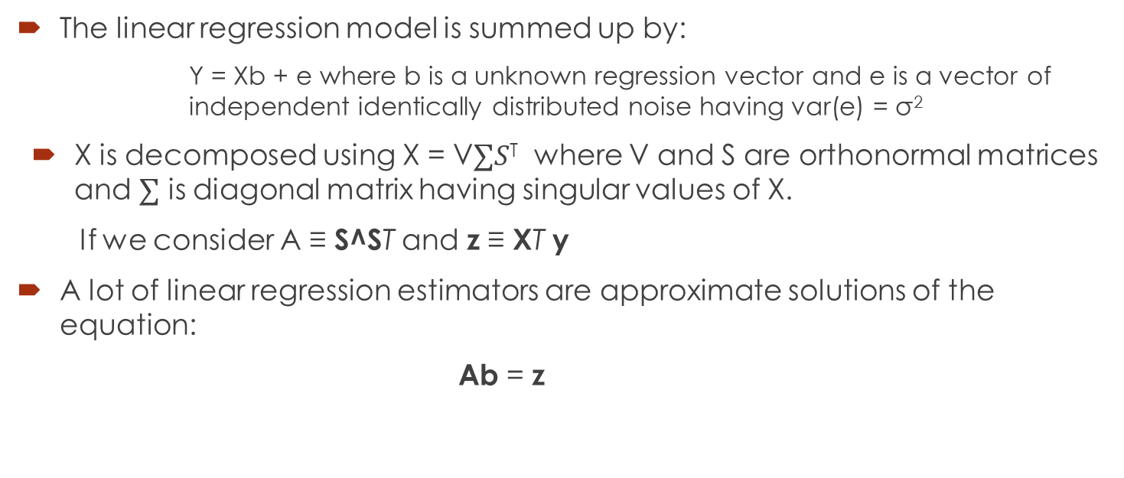
Algebraic Interpretation of Linear Regression
The linear regression model is summed up by:
Y = Xb + e where b is a unknown regression vector and e is a vector of independent identically distributed noise having var(e) = σ²
X is decomposed using X = V$∑S$^{T} where V and S are orthonormal matrices and $∑$ is diagonal matrix having singular values of X.
If we consider A ≡ S^ST and z ≡ XT y
A lot of linear regression estimators are approximate solutions of the equation:
Ab = z

Slide 17
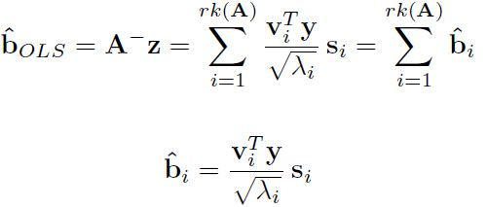


Algebraic Representation of Linear Regression
For ordinary least squares estimator, we can write:
For PCR estimator that regresses y on first p principal components, we can write:
For RR estimator we can write:

Slide 18

Algebraic Representation of Linear Regression
PLS Algorithm is equivalent to conjugate gradient method which is a procedure that iteratively computes appropriate solutions for Ab = z by minimizing quadratic equation: ½ b^{T}Ab – z^{T}b along directions that are A-orthogonal
The solution is obtained after p steps is equal to the PLS estimator obtained after p iterations.
This procedure is also closely related to Lanczos Algorithm, which helps in approximating eigenvalues. Lanczos uses the concept of Krylov Space to compute an orthogonal basis to produce a matrix that comprise of eigenvector-eigenvalue pairs. This provides us with the best approximation on eigenpairs.
The weigh vectors of PLS1 are identical to basis vector of Lanczos algorithm and PLS estimator is the solution of optimization problem

Slide 19
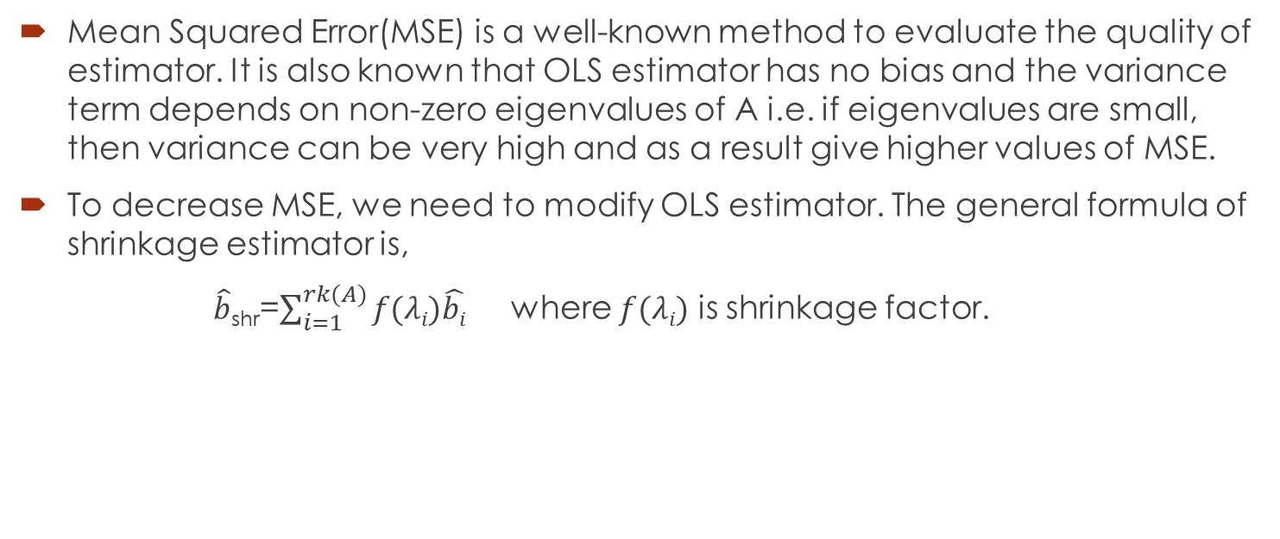
Shrinkage Properties of PLS Regression
Mean Squared Error(MSE) is a well-known method to evaluate the quality of estimator. It is also known that OLS estimator has no bias and the variance term depends on non-zero eigenvalues of A i.e. if eigenvalues are small, then variance can be very high and as a result give higher values of MSE.
To decrease MSE, we need to modify OLS estimator. The general formula of shrinkage estimator is,
$\hat{b}$_{shr}=$\sum_{i=1}^{rk(A)}{f(λi)\hat{bi}}$ where $f(λi)$ is shrinkage factor.

Slide 20


PLS Regression: Shrinkage Properties
For PCR, shrinkage factor is:
$f(λi)$ = $\left\{\begin{aligned}1 , i ≤p \\ 0 , i>p\end{aligned}\right.$
For RR, shrinkage factor is:
$f(λi)$ =$\frac{λi}{λi+γ}$
For PLS, shrinkage factor is:

Slide 21
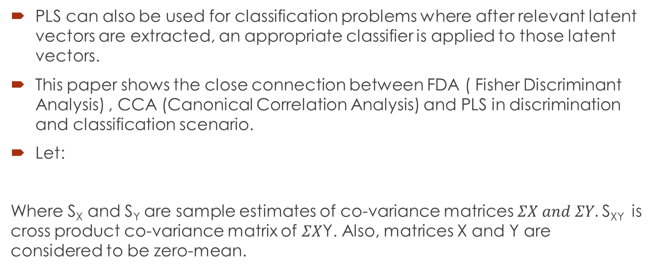
PLS Discrimination and Classification
PLS can also be used for classification problems where after relevant latent vectors are extracted, an appropriate classifier is applied to those latent vectors.
This paper shows the close connection between FDA ( Fisher Discriminant Analysis) , CCA (Canonical Correlation Analysis) and PLS in discrimination and classification scenario.
Let:
Where S_{X} and S_{Y} are sample estimates of co-variance matrices $ΣX and ΣY.$S_{XY} is cross product co-variance matrix of $ΣX$Y. Also, matrices X and Y are considered to be zero-mean.

Slide 22


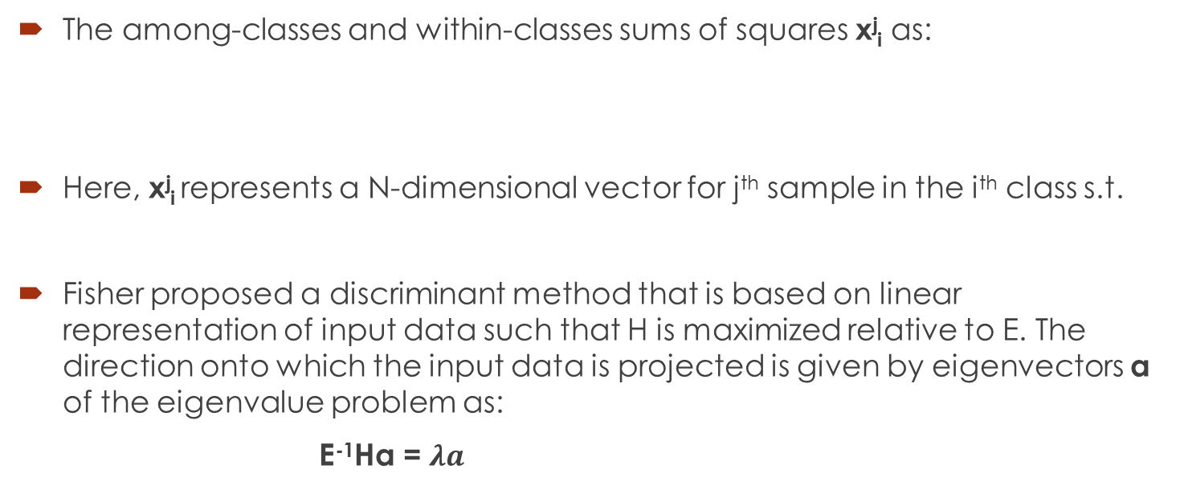
PLS Discrimination and Classification
The among-classes and within-classes sums of squares x^{j}_{i} as:
Here, x^{j}_{i} represents a N-dimensional vector for j^{th} sample in the i^{th} class s.t.
Fisher proposed a discriminant method that is based on linear representation of input data such that H is maximized relative to E. The direction onto which the input data is projected is given by eigenvectors a of the eigenvalue problem as:
E⁻¹Ha = $λa$

Slide 23


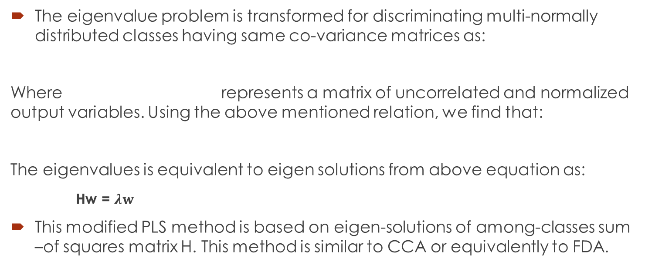
PLS Discrimination and Classification
The eigenvalue problem is transformed for discriminating multi-normally distributed classes having same co-variance matrices as:
Where represents a matrix of uncorrelated and normalized output variables. Using the above mentioned relation, we find that:
The eigenvalues is equivalent to eigen solutions from above equation as:
Hw = $λw$
This modified PLS method is based on eigen-solutions of among-classes sum –of squares matrix H. This method is similar to CCA or equivalently to FDA.

Slide 24
PLS Two-class Discrimination and Classification
In the case of two-class discrimination the direction of the first orthonormalized PLS score vector t is identical with the first score vector found by either the PLS1 or PLS-SB methods.
Orthonormalized PLS can extract additional score vectors up to the rank of X. It is computationally equivalent to CCA and FDA on deflated feature space matrices.
PLS provides more principled dimensionality reduction in comparison to PCA based on maximum data variation in X-space alone.

Slide 25


PLS multi-class Discrimination and Classification
For multi-class discrimination, the rank of Y matrix is equal to (g-1) groups which determine the maximum number of score vectors that can be extracted from orthonormalized PLS-SB method.
For eigen-problems, the below given formula represents projection matrix:
where X_{d} and Y_{d} are deflated matrices of eigen-problem. It can be written as:
This method is similar to two-class discrimination solution of eigen-problem and the among-classes sum of squares matrix using X_{d}

Slide 26
Non-Linear PLS: First Approach
This approach is based on reformulating the linear relation between score vectors t and u by as non-linear model as:
U = g(t) + h = g(X, w) +h
where g(.) is a continuous function and h is a vector of residuals.
This approach works on the assumption that score vectors t ,u are linear projections of the original variables.
The function, g(.) is modeled using several methods namely: polynomial functions, smoothening splines, artificial neural networks and radial basis functions.
This approach elaborates about the need for linearization of nonlinear mapping g(.) and successive iterative updating of weight vector, w.

Slide 27
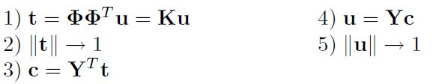
Non-Linear PLS: Second Approach
This approach is based on mapping of the original data by means of a nonlinear function to a new representation i.e., data space where linear PLS is applied.
This approach is based on kernel-based learning of non-linear PLS by modeling relation between observed variables, regression and classification problem.
This approach maps original X-space data into high-dimensional feature space F. Kernel trick then applied to estimation of PLS and it reduces feature space , F into linear PLS.
The kernel form is formed using NIPALS algorithm as:

Slide 28
Non-Linear PLS: Comparison
Kernel PLS approach is easily implementable, computationally less demanding and is capable of modeling difficult non-linear relations. However, there is a loss of interpretability of results with respect to original data.
First Approach focusses on keeping latent variables as linear projections of the original data which is inadequate in construction of some data situations.
The researchers need to choose one of the two approaches based on the problem in their hand, simplicity of solution and interpretation of results.

Slide 29
Conclusion
The PLS method projects original data onto a more compact space of latent variables.
The PLS method can leads us to the deletion of unimportant variables so as the result we will have a significant cost reduction.
PLS tools based on score and loadings plots allows to better
understand data structure
observe existing relations among data sets
detect outliers in the measured data

Slide 30
Future Scope
This paper draws connections between PCA, CCA and PLS so that we can design new algorithms by incorporating good properties of individual methods and thus build much more powerful machine learning tools.
Although PLS Regression is still considered to be a method or algorithm. We believe that there is a lot more to explore in PLS regression that can be beneficial than other models. PLS Regression can emerge as a rigorous statistical model with more theoretical evaluation.

